Slide 1
Anxiety
Ics presentation

Slide 2
Let’s talk about anxiety
The rise of anxiety and “the anxious generation”.
What is ”normal” or age-appropriate anxiety vs. an anxiety disorder?
What contributes to anxious feelings in children?
Brain development and the 5 to 7 shift.
What helps? What does not?
Emotional regulation and co regulation.
Neurodivergence, trauma, and anxiety.
When extra support is needed.

Slide 3
The anxious generation
Anxiety disorders are amongst the most common mental health issues in children.
Recent Canadian statistics report approximately 9.6% of children ages 5-11 report a mental health issue---anxiety being prominent. Some studies (US) indicate a 17-20% increase in the last 10 years.
Impact and ongoing effects of COVID. Reported levels of anxiety nearly doubled.

Slide 4
Factors contributing to increase in anxiety
Increased awareness of mental health issues; decreased stigma in reporting and seeking help.
Societal stressors.
School violence.
Global, economic, and political unrest.
War.
Greater access to technology and information.

Slide 5
Fight, Flight, Freeze Response
https://youtu.be/FfSbWc3O_5M
What is the Fight-Flight-Freeze Response?
When your child perceives something as scary or overwhelming, their brain activates the amygdala, which is like a built-in alarm system. This sets off a chain reaction in the body that prepares them to:
Fight 🥊 – Their body gears up to protect itself. This can look like:
Angry outbursts or tantrums
Yelling, hitting, or throwing things
Talking back or being defiant
Flight 🏃‍♂️ – Their body prepares to escape the situation. This can look like:
Running away or hiding
Avoiding certain situations (e.g., refusing to go to school)
Complaining of stomachaches or headaches to get out of something
Freeze 🧊 – Their body shuts down as if they are “playing dead.” This can look like:
Zoning out or going quiet
Feeling unable to move or respond
Being unable to make a decision

Slide 6
Why Does This Happen? This response is a survival mechanism, designed to help humans react quickly to threats. However, children with anxiety may experience this response even when there’s no real danger—like when they have to speak in class, meet new people, or try something unfamiliar.
How Can Parents Help?
Recognize the signs – Instead of seeing it as “bad behavior,” understand that their brain is in survival mode.
Stay calm – Your child looks to you for reassurance. If you stay calm, they are more likely to calm down.
Teach grounding techniques – Deep breathing, counting, or squeezing a stuffed animal can help them feel safe.
Help them name their feelings – Saying, “It looks like you're feeling scared,” can help them understand their emotions.
Practice coping skills ahead of time – Teach relaxation strategies when they are calm, so they can use them in anxious moments.
Anxiety isn’t a choice—it's the brain's way of trying to protect your child. By understanding the Fight-Flight-Freeze response, you can support them with patience, tools, and reassurance.

Slide 7
Hurried child syndrome
Dr. David Elkind in the 1980’s.
Pushed to high levels of academic, extracurricular and social activities.
Excessive busyness=stress.

Slide 8
The impact of busyness and stress on brain development
Chronic stress can disrupt development in several ways:
The amygdala (the fear center) becomes overactive, potentially increasing anxiety.
The prefrontal cortex (responsible for decision making and emotional regulation). Stress can impair its growth making it harder for children to manage emotion.
The hippocampus (responsible for learning and memory) is affected by high cortisol levels, making it harder for children to concentrate and retain information.

Slide 9
The impact of stress on emotional development
When children do not get enough unstructured play and rest, they have fewer opportunities to learn to manage emotion, handle frustration, and calm themselves.
They may also experience:
Increased anxiety about performance: “I have to be perfect at everything”.
Lower frustration tolerance- they may not have enough downtime to process emotion.
Reduced creativity and problem-solving skills because they are constantly in structured environments with little room for free exploration.
Sleep and eating disruptions directly affect mood and anxiety levels.
Emotional outbursts.
Difficulty focusing in school.

Slide 10
While engagement and learning new skills are important for children, too much busyness contributes to anxiety. Finding a balance between structured activities and free, unstructured time allows children to develop resilience, creativity, and emotional wellbeing.

Slide 11
Screen time
Higher screen time correlates with elevated symptoms of anxiety and depression.
Excessive screentime linked to decreased social coping skills.
Development of craving behaviors that resemble substance dependence.
Impulsive behaviors and attention issues.
Structural changes in the brain related to cognitive control and emotional regulation.
Lower well-being, less curiosity, self control, and emotional stability.
Loneliness: disconnection from self and others

Slide 12
Recommendations for parents
Set screen time limits. Current recommendations are not more than 2 hr/day.
Engage in screen free activities that foster face to face interactions, ie. outdoor play, board games, reading books, bible time.
Be mindful of content: use learning apps, no social media, cultivate awareness of anything that is not age appropriate that may be contributing to fear or anxiety.
Choose co-viewing to facilitate understanding, context, and promote critical thinking and family bonding ie. Watching The Chosen or Bible Project videos.
Model healthy screen habits: demonstrate balanced screen usage by prioritizing presentness.

Slide 13
What do kids say?
"What if something bad happens to Mom or Dad?" → Fear of separation or losing a loved one.
"I don’t want to go to school—I’m scared I’ll mess up." → Fear of failure, perfectionism, or performance anxiety.
"Nobody played with me at recess. What if I don’t have any friends?" → Fear of rejection or social anxiety.
"I don’t want to sleep alone. What if there are burglars or monsters?" → Fear of the dark or nighttime worries.
"What if I say something dumb and everyone laughs?" → Fear of embarrassment or being judged.
"I don’t want to go to soccer practice. I’m not as good as the other kids." → Fear of not being good enough or comparison anxiety.
"What if there’s a fire, a tornado, or an earthquake?” → Fear of real-world dangers beyond their control.
”What if I throw up?”

Slide 14
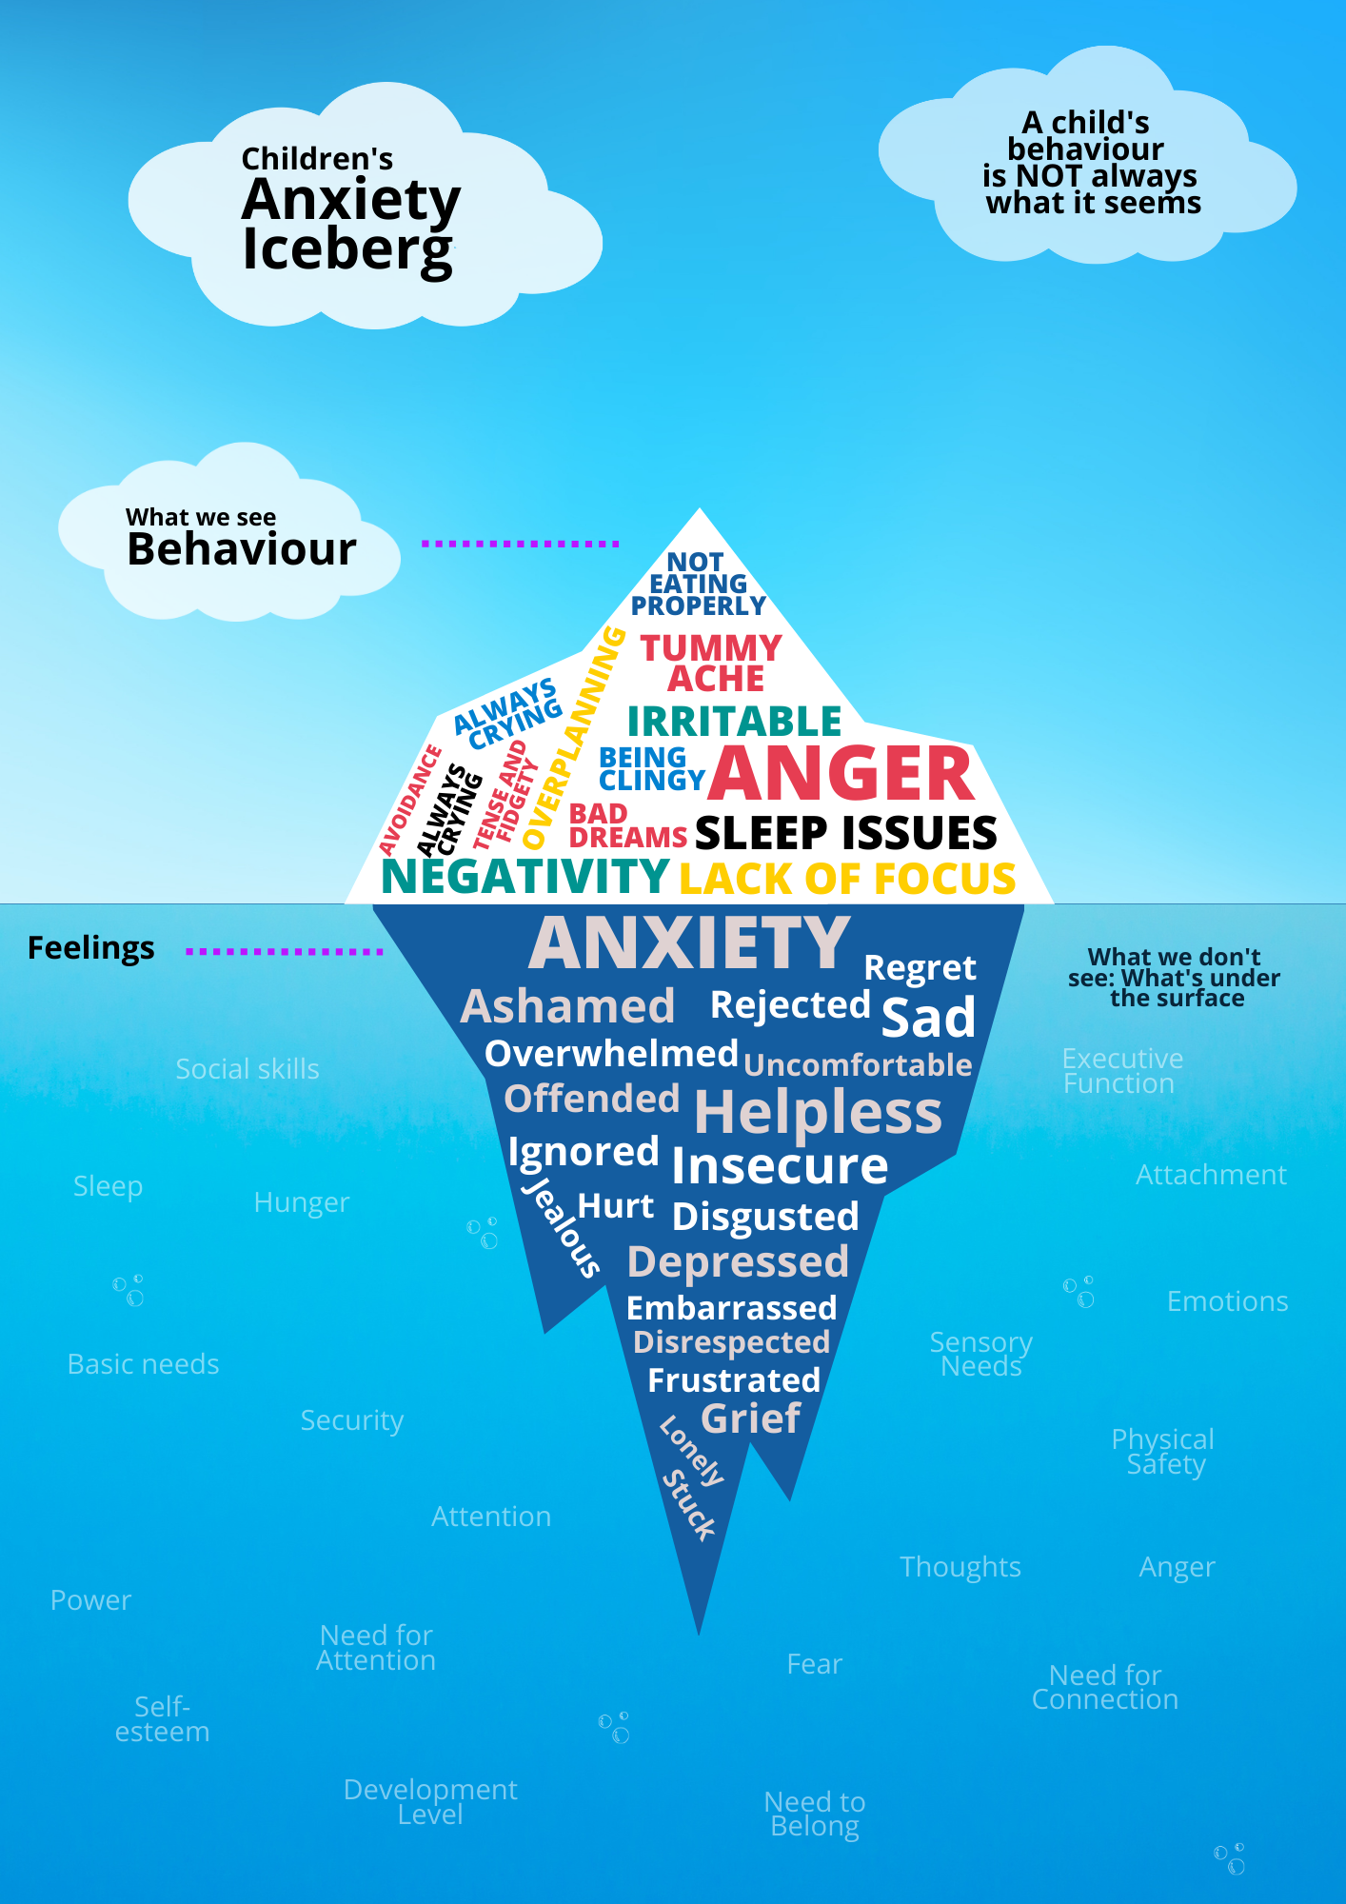
Anxiety iceberg
What we see- Behaviors.
What we do not see- thoughts, beliefs,
Emotions, overstimulation.
Be curious and compassionate, cultivate
awareness through naming emotion and
Identifying triggers, bodily sensations, and
develop coping strategies and toolkits.

Slide 15
Brain development: the 5 to 7 shift.
A time of rapid brain development in the areas of emotional regulation and executive function: the ability to manage emotion, problem solve, and process more complex information.
They begin to think more about how others see them and how they compare to their peers. Anxiety may increase around making mistakes, being judged, or fitting in. TIP: encourage self- compassion and a growth mindset! “You’re still learning! Let’s keep practicing this together!”
They are learning greater emotional regulation….but not always! While they are developing more impulse control, stress, fatigue or frustration can still cause meltdowns and emotional outbursts. TIP: recognize emotional regression as normal. Teach and model co-regulation strategies like deep breathing, a quiet space, or offer a quiet comforting presence when your child is overwhelmed at home.

Slide 16
The 5 to 7 shift
A shift from magical thinking to reality awareness: A movement from believing in monsters to seeing the world more logically, which can introduce new fears about natural disasters, crime, accidents, death. We may see a lot of overthinking and what if questions. TIP: normalize their fears and provide age appropriate reassure. Instead of dismissing fears, validate and talk about safety strategies.
A growing desire to feel capable and in control. This may look like resisting help from parents, but they still need emotional support. Likewise, we might see perfectionism anxiety and the pressure they feel to get things right. TIP: Normalize mistakes as part of a growth mindset. Give them age-appropriate choices and responsibilities to build competence and confidence through small, low-risk decisions to help strengthen their sense of control.

Slide 17
Signs that a child (and parents) may benefit from professional help
A child’s worries prevent them from engaging in normal activities such as: going to school without extreme distress, playing with friends or engaging in social situations, sleeping through the night without excessive fears.
Physical symptoms without a medical cause: stomach aches, headaches, nausea; muscle tension or unexplained pain; shortness of breath or rapid heartbeat.
Excessive perfectionism and fear of failure: rigid, self-critical thinking that can lead to avoidance of previously enjoyed activities, meltdowns or shutdowns when they make mistakes; a constant need for reassurance (did I do it right? Every few minutes)
Extreme separation anxiety: while some clinginess is normal, extra resources may help children who panic or have meltdowns when a parent leaves, or if a child has excessive fears about parent safety, or refuses to sleep alone, needing excessive reassurances.

Slide 18
More signs:
Persistent and uncontrollable worries: “WHAT IF” about injury, illness, death, natural disasters, burglars, unlikely dangers, school, friendships, performance.
Frequent emotional outbursts or shutdowns: tantrums, anger outbursts over minor issues; refusing to speak- emotional flooding when overwhelmed, running away or hiding when anxious situations arise.
Avoidance of normal activities.
Sleep problems: taking over an hour to fall asleep due to worrying, waking up multiple times in the night needing reassurance, nightmares about their anxious thoughts.
Social withdrawal and friendship struggles: fear of making mistakes, being judged or excluded, avoiding interactions with classmates or playdates, not speaking in class or refusing to participate in group activities. Be aware of bullying.
Duration: 6 months + significant interference with child’s daily activities.

Slide 19
How to help in the 5 to 7 shift
5 to 7 is a big cognitive shift, one of the best ways to support your child to be their safe base.
Compassion!
Encourage a growth mindset: the 5 to 7 shift brings about a fear of failure. Instead of praising outcomes, praise effort; model making mistakes and handling them calmly at home.
Reduce toxic stress and cultivate home as a place of rest and recovery from the exhausting work of growing and learning at school. Limit overstimulation.

Slide 20
What helps/what does not
Help them name and manage (regulate) their feelings. Help them develop an awareness of anxious thoughts and how they feel in their bodies, what the words that pass through their minds sound like, as well as awareness of peace and calm feelings, places, people, activities, etc. Help them find the strategies that bring down heightened emotion and calm their bodies. Utilize co-regulation, teach simple anxiety calming strategies like breathing exercises, movement-based regulation (jumping, bilateral stimulation, fidgets etc.), or setting a worry timer- “lets talk for 5 minutes, pray and move on”.
Model calmness and resilience.
Be aware of over reassurance and over managing/shielding children from the frustration that is a necessary part of learning and growth.
Discipline is often counter productive. Consequences are natural results for behavior– help them make amends if possible.
Logic doesn’t work either. When anxious the survival part of the brain is active, this must be soothed first. Validate, regulate, help them make an empowered decision.

Slide 21
The learning space
The Learning Space (Dr. Becky Kennedy)
Not knowing
Knowing
FRUSTRATION

Slide 22
Zones of regulation

Slide 23
toolkit
Music
Crafts
Movement: dance, sports, walking, stretching
Bilateral movement ie. Butterfly tapping
Polyvagal techniques: singing, humming, gargling
Ice cubes in hands or back of the neck, cold shower, facial ice plunge
Breathing techniques
Grounding
Distraction (not avoidance): reading, puzzles
Talking
Journaling
Comfort: pets, stuffies, people
Alone time

Slide 24
When to help
When to help:
When a child is so overwhelmed they cannot think clearly – RED ZONE
When they are shutting down or feel unsafe.
If they are a danger to themselves or others.
If they haven’t found their coping skills and tools yet.

Slide 25
When to step back
Once they begin to use regulation strategies independently.
If they need space to calm down before talking.
When frustration is a necessary part of the learning space. Here, you can encourage, cheerlead, even coach from the sidelines.
In this space, stay attuned to your child, don’t check out!

Slide 26
The emotional impact of parenting an anxious child
Feeling
helpless
Feeling
guilty or inadequate
Feeling
frustrated, annoyed, inconvenienced, disgusted, angry
Feeling
overwhelmed.

Slide 27
Self regulation strategies for parents:
Grow in empathy and compassion.
Anxiety is contagious! What am I feeling? Getting to know your own anxiety triggers and how it impacts your parenting and other relationships. Be aware of how stress is increasing your own anxious feelings.
Give yourself permission to step away.
Don’t expect perfection-from yourself or your child. Focus on the long game of parenting and build into your attachment relationship with your child. Show and verbalize unconditional love, model healthy mistake making.
Develop your own personal tool kit for healthy emotional regulation.
Practice self care. Prayer!
Seek support!

Slide 28
Important considerations for anxiety in children
Anxiety resulting from childhood trauma: accident, illness, abuse, domestic violence, poverty, parent illness, parent mental health challenges, generational trauma, death/tragedy etc.
Family systems! We affect each other. Stress in the home greatly impacts children.
Neurodivergence: ADHD, Autism Spectrum Disorder, Dyslexia, Dyspraxia (developmental coordination disorder), Tourette Syndrome, etc.
These children and families greatly benefit from the professional support of Physicians, Psychologists, Counsellors, Social workers, and life coaches.

