Slide 1


New Curriculum & Reporting
Lethbridge School Division

Slide 2
K-5 New Curriculum
ELAL
Math
Science
Physical Health and Wellness
Social Studies Pilot 2024/2025

Slide 3
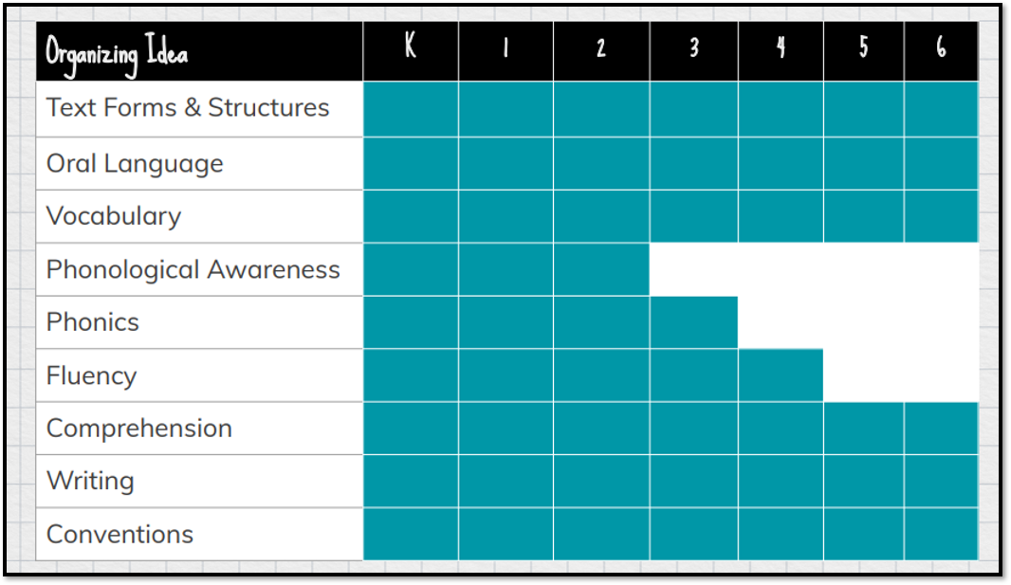
English Language Arts & Literature (ELAL)

Slide 4
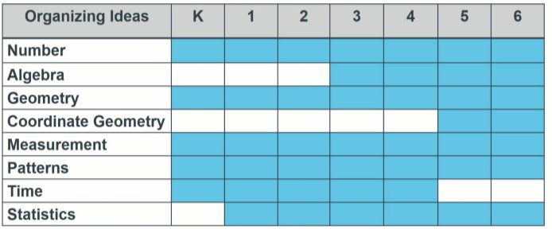
Math

Slide 5
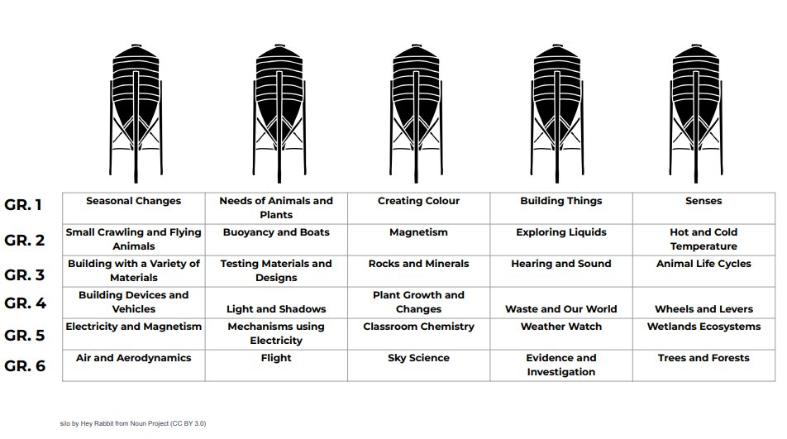
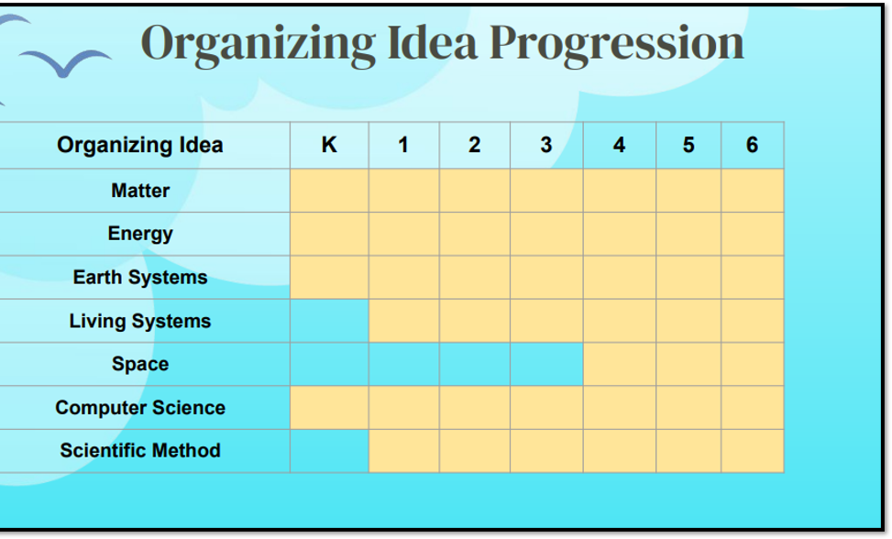
Science
Former Curriculum
New Curriculum

Slide 6
Physical Health & Wellness
Organizing Ideas Physical Health & Wellness
Active Living
Movement Skill Development
Character Development
Safety
Healthy Eating
Healthy Relationships
Growth & Development
Financial Literacy

Slide 7
Social Studies (Draft Curriculum)

Slide 8
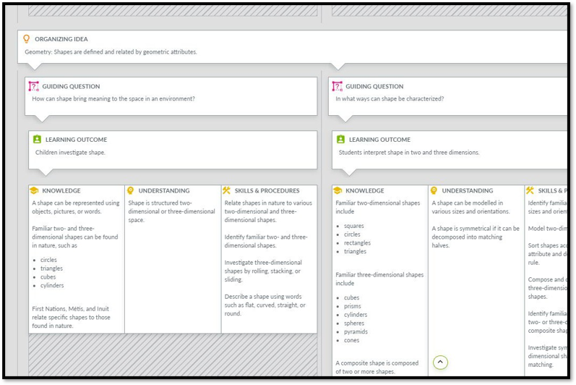
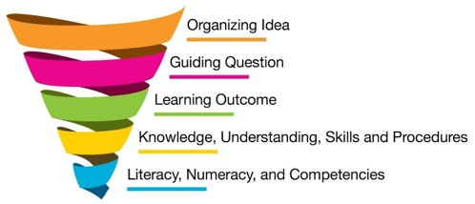
Curriculum Layout

Slide 9

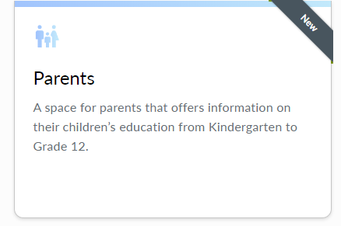
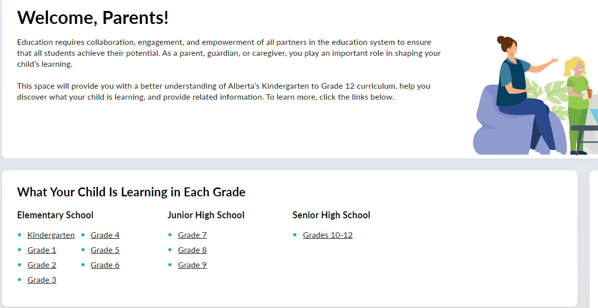
Parent Hub

Slide 10
Aligning Reporting with New Curriculum
Teachers shall ensure that information is effectively communicated to parents about:
Their child’s knowledge, understanding and skills developed through a set of learning outcomes as referenced in the curriculum.
How well their child is doing in each subject.
(Guide to Education, 2024)

