Slide 1
Raising Resilient Children
Lisa Romaniuk BSW RSW
www.lisaslifeconnections.com

Slide 2
What does it mean to be resilient?
Merriam-Webster Dictionary defines resilience as “the ability to recover from or adjust easily to misfortune or change.”
There are many definitions of this word that refer to concepts of adapting, adjusting, or withstanding challenges or adversity.

Slide 3
The resiliency question
What makes one child, one person, more “resilient” than another?
Is this something that people are predisposed to? Can it be changed? (Nature vs. Nurture)

Slide 4
Nature vs nurture
Research tells us that many factors can predispose a child to being sensitive to stress, including family history and level of stress being experienced by the mother during pregnancy.
However, research also tells us that environmental factors will play a role in “turning on” the genes with a stress response or not. (epigenetics)

Slide 5
The good news
Research also tells us that when you change the environment, you change the brain. This means you change the brain’s response to stress.
We can teach our brains, and children’s brains to adapt to stress differently, building resilience by doing so.

Slide 6
Even better news
Prayer is one of the most effective ways to help our brains adapt to stress. Studies show that a daily practice of gratitude creates resilience to depression and anxiety. By focusing on positive belief, the brain looks for the good in the world.
Prayer changes your child’s brain!

Slide 7
Four needs for building resilience
Research by Dr. Gordon Neufeld point to four areas of development for children that foster resiliency.
These four areas can make all the difference even when we can’t change certain environmental stressors such as a global pandemic.

Slide 8
1. The attachment relationship
The consistent presence of emotionally available caregivers will make all the difference in a child’s life. It is important that at least one caregiver is relatively emotionally healthy and tuned in to the child’s needs on a consistent basis.
This secure attachment provides a sense of safe connection for a child to know s/he has a safe source of support when needed.

Slide 9
2. Invitation to exist in adult presence
Dr. Neufeld refers to this concept as giving the child an opportunity to “rest” in the comfort that they are allowed to be who they are, flaws and all. It means not constantly “shushing” or disregarding a child and his/her emotions/needs, but acknowledging them.
Even when consequences are needed, a child is reassured that they are still cared for, important, and allowed to be who they are. This helps them remain connected to their source of support: healthy adults.

Slide 10
Finding rest
“I have told you these things, so that in me you may have peace. In this world you will have trouble. But take heart! I have overcome the world.” John 16:33
We are to model God’s love for us to our children. By teaching them they can rest in our love and in the secure attachment with us, we are showing them that all believers can do the same with God.
This is especially important in troubled times.

Slide 11
3. Safety to feel emotions
Dr. Neufeld has found in his research that in order for a child’s heart to remain “soft”, it is important that s/he is encouraged to feel the feelings and express them in healthy ways. Children with hardened hearts tend to turn to unhealthy ways to cope.
Growth and resiliency does not happen without vulnerability. It is important to teach children that they can be safe to be vulnerable with us.

Slide 12
4. play
In order for children’s brains to develop and mature, they need time for unstructured, spontaneous, screen-free play time.
This type of play results in development of the neocortex of the brain, which helps with higher functions such as perception, decision making and language. These areas of the brain are important in developing resiliency.

Slide 13
The importance of connection
The reason these factors are so important for children to develop resiliency is that the key factor is social support. The most resilient people are the most connected people.
Helping children learn from an early age that it is not only okay but important to ask for help when you need it will be key to their resiliency throughout life.

Slide 14
Resisting cultural norms
Our culture continues to be on a path towards more and more compartmentalization and separation. It is leading to an epidemic of loneliness, anxiety and stress.
Helping children resist the tendencies towards relying on technology, screens, and disconnection from community will help them build resiliency through healthy attachments.

Slide 15
Nurturing self-regulation
Another factor in building resiliency is helping children to regulate their emotions in healthy ways. Self-regulation is very difficult to “teach”, as it is meant to develop as the brain matures.
It’s important to trust the natural development that is meant to occur in children’s brains to encourage increasing self-regulation over time. We need to remember we as adults have a hard time with self-regulation at times as well.

Slide 16
3 Stages of development
1. A solid, consistent and secure attachment to one or more primary caregivers.
2. Individuation – knowing who you are and what your boundaries are.
3. Socialization – respecting the differences of others.

Slide 17
Our responsibility as adults
It’s important to remember that children who have not been able to form secure, healthy attachments have likely not developed a healthy sense of self. When these two developmental needs are not met, their ability to socialize in healthy ways will not be easy for them.
No matter the age, we need to go back and help children develop those stages in order wherever possible.

Slide 18
How can community help?
In addition to a child’s home life, the experience of community at school and church will make a difference.
Children need “empathetic witnesses” in their lives: people who invite them to exist in their presence and validate their emotions. Giving the child the message: “I see you and I hear you. You are worthwhile” will make all the difference.

Slide 19
What to do with kids “acting out”
“acting out” is actually healthy… they are “acting out” what they often do not have the words to express
It is natural for kids to “push back”. It is called “counterwill” and it is important for healthy human development and healthy boundaries.
Kids need the “alpha” presence of caring adults who maintain the boundaries while also validating the emotions.

Slide 20
It’s all about relationship
We have more of an impact than we realize whenever we have a secure attachment with a child.
If you are frustrated with your child, do what you can to manage your own emotions in healthy ways. That is your responsibility as the adult.
Children develop resiliency when connected to healthy adults who validate their emotions, help them develop their sense of self, and maintain healthy boundaries for behavior while doing so.

Slide 21
What about anxiety?
Psalm 13:2 says “How long will I have anxious concern, with grief in my heart each day?”
David poured out his heart to God in prayer, trusting fully in God’s love.
God invites us to unburden ourselves to him.
“Throw all your anxiety on Him, because he cares for you.” 1 Peter 5:7

Slide 22
God’s answer to Anxiety? relationship
The ultimate answer to anxiety is our relationship with God.
We are called to be a model of this to the children in our lives. As we rely and trust in Him, we teach them to do that, first with us and then leading them to Him.
God designed our beautifully complex brains to respond to threats. Understanding this, and how to soothe that response when the threats are not actually as dangerous as we think, is what helps us manage anxiety.

Slide 23
The brain’s alarm system
Our brains are designed to set off an alarm when there is a threat.
Anxiety is when that alarm system is activated for prolonged periods of time or repeatedly activated.
We get alarmed when we are facing the lack or loss of proximity to what or whom we feel attached to. The reason is that secure attachments bring a sense of safety and soothe the alarm system in the brain.

Slide 24
Alpha presence
Children’s alarm systems are soothed by secure relationships with adults who have an “alpha presence” in their lives.
Alpha presence means that the parent is the authority in the child’s life and is in charge. A parent that presents him or herself with the sense of being an alpha, will communicate to the child, “Don’t worry, I got this.” Even if you don’t know for sure what to do as a parent, presenting this confident, loving authority will soothe a child’s alarm system.
This is most effective when it is combined with also inviting the child to “exist” in your presence. This means making sure the child is seen, heard, and validated. Hearing and validating your child’s concerns while still letting them know you are in charge is key.

Slide 25
Other ways to be the alpha
Take
Take the initiative with connection.
Present
Present yourself as the child’s answer.
Protect
Protect the child’s dignity.
Act
Act as the child’s comforter and compass point.
Take
Take charge of situations and circumstances.
Take
Take the lead in solving problems.
Be
Be trustworthy.

Slide 26
Be accepting
Anxiety is a common human experience. The less we focus on it as a “problem” in our children’s lives, the more likely they are to manage it well.
When your child is feeling anxious, talk about it as something that happens from time to time. Hear and validate your child’s experiences. Then take the alpha lead in finding solutions and communicating confidence that it will be okay.
It’s okay to share with your child that many people experience anxiety, even yourself. And also that there are many ways to manage it and feel better.
Provide your child with experiences that soothe his/her senses. Physical touch, calming sensations, and time to settle emotions and thoughts are very helpful. Continue to communicate your alpha presence.

Slide 27
Cultivating courage
Help your child identify what they would like to be feeling/experiencing if they had no anxiety. What would be different for them?
Help your child to see that it is okay to feel the anxiety and also the desire for it to be better at the same time.
Help your child to see that having courage does not mean the absence of fear. Overcoming anxiety often means dealing with our fears and “doing it anyway”. It is by facing our fears that we overcome them.
Remain the alpha presence, letting your child know you are there for him/her no matter what. Because of that, no matter what happens, he or she will be okay.

Slide 28
Q and A

Slide 29
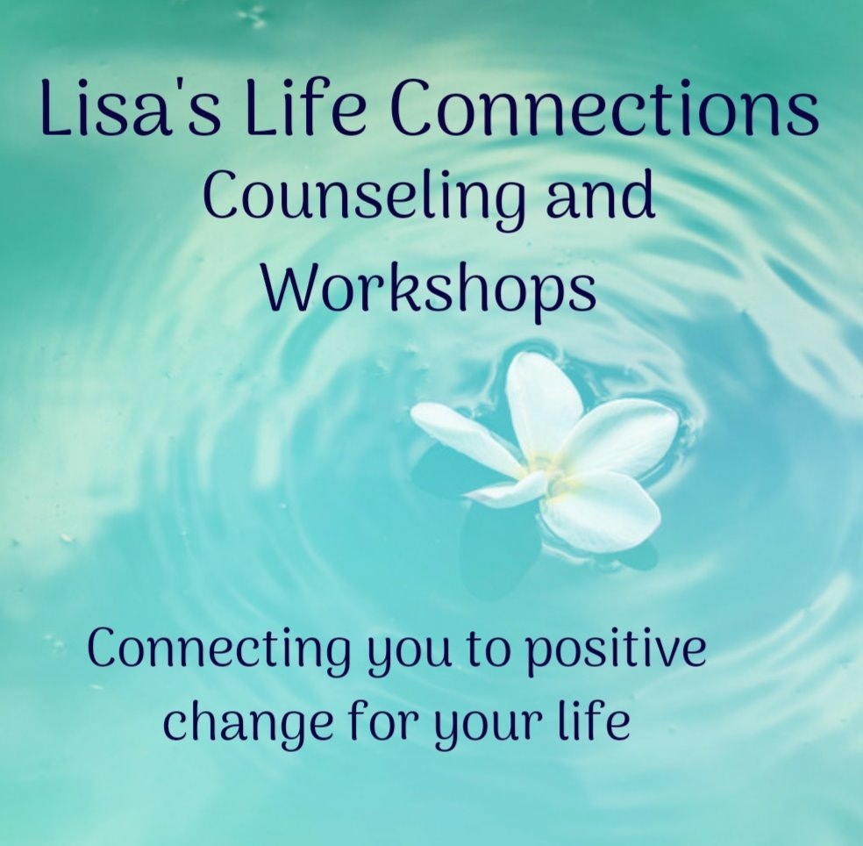
How to connect with me…
Lisa Romaniuk BSW RSW
403-795-6156
lisaslifeconnections@gmail.com
www.lisaslifeconnections.com
Look for Lisa’s Life Connections on Facebook and Instagram
30 years of counselling experience
Certified Life Coach

Slide 30
Resources
Hold on to Your Kids by Dr. Gordon Neufeld and Dr. Gabor Mate
It Didn’t Start with You: How Inherited Family Trauma Shapes Who We Are and How to End the Cycle by Mark Wolynn
www.neufeldinstitute.org
www.drgabormate.com
Neurobiology and the Development of Human Morality: Evolution, Culture and Wisdom by Darcia Narvaez
Parenting from the Inside Out by Daniel Siegel
The Boy Who Was Raised as a Dog by Bruce Perry

